Slide 1
THE AUTOMOTIVE REVOLUTION IS SPEEDING UP
MIS 760-B
IT Strategy
Akshay Mulay
Xiting Wang
Wenpei Wang
Balaji Katakam
Swapnil Panchal
Jiancheng Zhao
Jianjie Gao

Slide 2
Table of Content
Title
Overview
Key Findings
Current situation of the technology
Potential Driving Factors
Impact of Disruptive Trends
Potential Growth
Focus on new business model
Developing more granular market perspectives
Landscape model
Business Future significance
Analysis Tools
Outcomes and Conclusion

Slide 3
THE AUTOMOTIVE REVOLUTION IS SPEEDING UP
By Kersten Heineke, Timo Möller, Asutosh Padhi, and Andreas Tschiesner
Copyright © 2017 McKinsey & Company
https://www.mckinsey.com/industries/automotive-and-assembly/our-insights/the-automotive-revolution-is-speeding-up

Slide 4
Introduction
Balaji Katakam
Technological advancements have changed human demands in automobiles and are going to change the way people use them.
Artificial intelligence & Machine Learning is poised to become a base technology for every engineering department.
Customers talk more about systems and technologies embedded in cars than about horsepower.

Slide 5
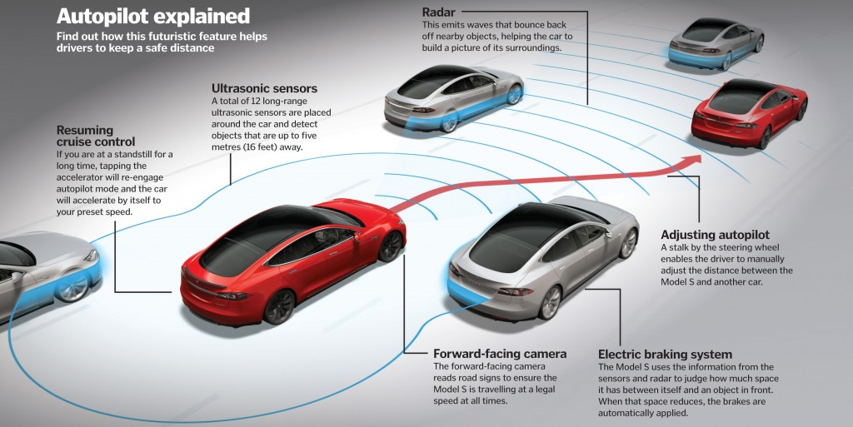

Slide 6
Key Findings
Balaji Katakam
The industry has been talking about the four disruptive trends changing the rules in the mobility sector:
Autonomous driving
Shared mobility
Connectivity
Electrification.
The four disruptive, technology-driven industry trends are gaining significant momentum.
Scenarios with varying technology diffusion show differences in revenue potential.
The potential growth of disruptive technologies varies widely by 2030
The share of revenue from disruptive business models could increase from around 1% to about 25% by 2030.
These four disruptive trends can occupy a large share of the automobile market and their growth scope has been studied with respect to practical aspects.

Slide 7
Current situation of the technology
Swapnil Panchal
Few Developments which illustrate advances:
Autonomous Driving: 80% will share autonomous technology by 2020
Shared Mobility: 1% increase to 80% increase once robo-taxis are available
Connectivity: 100% Embedded Systems in upcoming vehicles
Electrification: 5% to 50% xEV (Electrified Vehicle Power terrain)

Slide 8
Swapnil Panchal
Few Potential Driving Factors that will achieve Automotive Revolution:
Battery Cost and Scale: To attain parity in cost of profitability and ownership between battery operated and internal combustion engine vehicles, the battery should cost 25-40% less than the current price.
Exploit shared mobility: The addressable market scope should be broadened, and it would eventually extract maximum potential from ‘shared mobility’. The cost of pooling should cost much lower than typical ride hailing offer.
By attaining similar prospects, distinct scenarios will unfold depending on discrete variables thereby;
Technological Focus Shift
Granular Market
Customers becoming significant

Slide 9
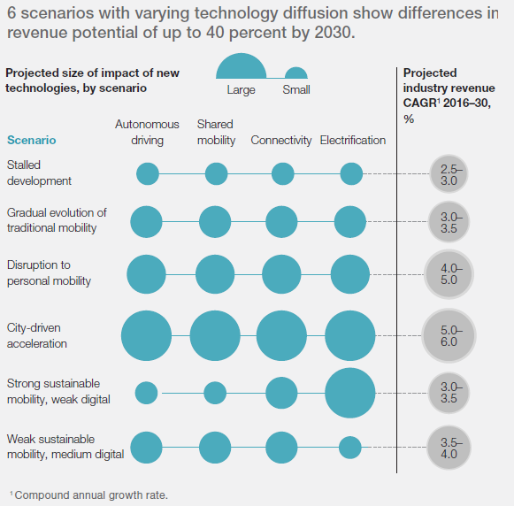
Xiting Wang
Four disruptive trends, impact on the six potential mobility scenarios:
City-driven acceleration is the major task that the new technologies will involved in the future
All industry seem to present a path of growth, but the variation in revenue potential across the six scenarios could have a huge different

Slide 10
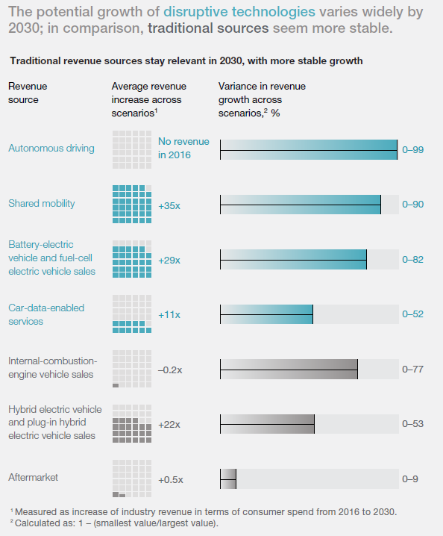
Xiting Wang
The potential growth of disruptive technologies compare with traditional source.
Shared mobility has the largest average revenue increase, so we could see that the growth of disruptive technology is more likely
We could see that the variance in revenue growth is also the disruptive technologies have more potential growth

Slide 11
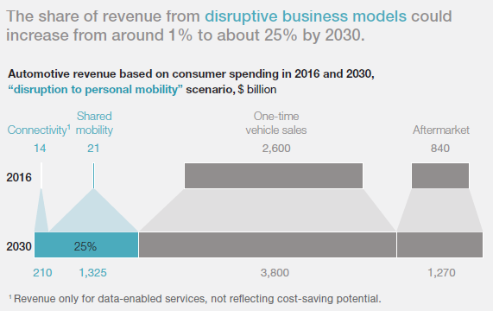
Focus on new business model
Wenpei Wang
Requirements for reaching new business model:
Perfect vehicle connectivity and commercial introduction.
Widespread uses for smartphones.
Mature technologies for electrified powertrains to achieve profits.

Slide 12
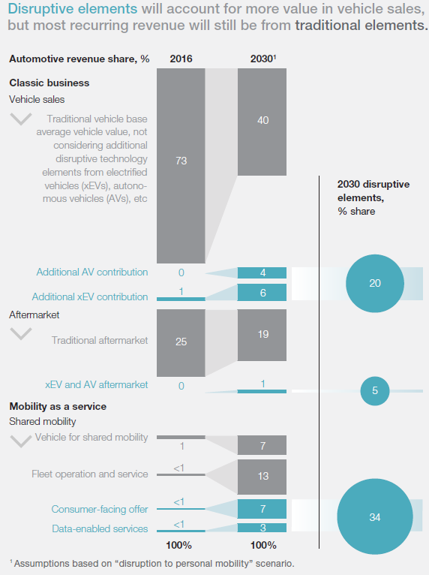
Developing more granular market perspectives
Wenpei Wang
Pay attentions on clients service.
Two factors are primarily responsible for the need for a granular market approach:
Different growth rates.
Different speeds of trend adoption.

Slide 13
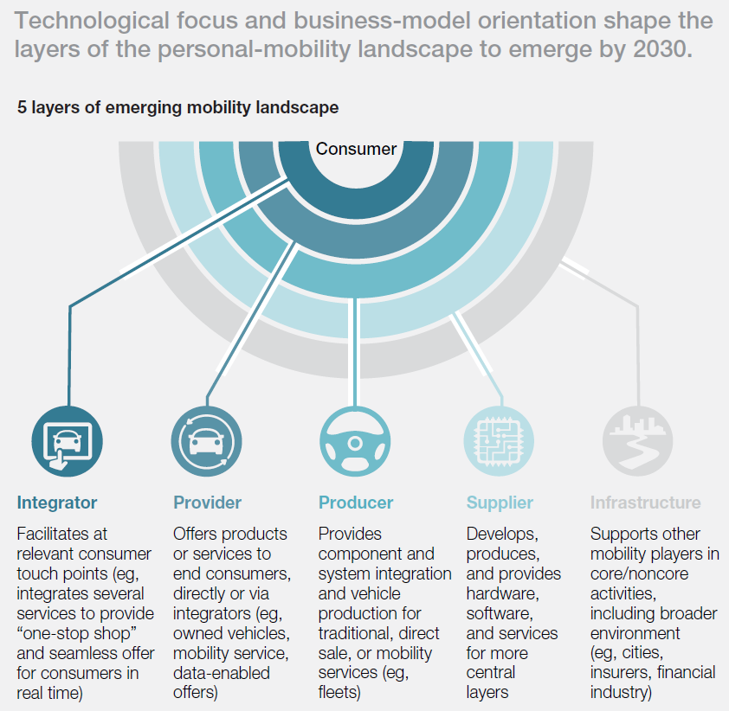
Landscape model
Jiancheng Zhao
Consumer-centric new landscape
Broader than traditional industry
More participants
Well-bedded

Slide 14
Business Future significance
Jiancheng Zhao
Advantages
Players can involve in multiple technologies
Can deliver value to the customers better
Each part of the industry can make direct contribution to the whole picture
Broader audience → more sales
Can be more focus on specific technologies → better deliver to the market

Slide 15
SWOT Analysis
Jianjie Gao
Strengths
Disruptive technology
Involve in multiple technologies
New business model
Weakness
Play more than one role
Capacity to deliver value
Mutually reinforcing trends
Opportunities
Granular market approach
Increasing investments
Increasingly diverse playing field
Disruptive, technology-driven industry trends
Threats
Traditional products and services
Unable to dominant
Technological and economic challenges
Transition for classic industry
Notes:
Two factors are primarily responsible for the need for a granular market approach: different growth rates and different speeds of trend adoption.

Slide 16
SWOT Analysis
STRENGTHS – S
WEAKNESSES – W
Disruptive technology
Involve in multiple technologies
New business model
Play more than one role
Capacity to deliver value
Mutually reinforcing trends
OPPORTUNITIES
SO STRATEGIES
WO STRATEGIES
Granular market approach
Increasing investments
Increasingly diverse playing field
Disruptive, technology-driven industry trends
Use disruptive tech to develop different business for various markets
Follow trend with different tech
Play significant role in each area
Differentiate value for various markets
Invest in necessary tech for further satisfy their customers’ anticipation
Participate in various aspects to promote integration
THREATS
ST STRATEGIES
WT STRATEGIES
Traditional products and services
Unable to dominant
Technological and economic challenges
Transition for classic industry
New techs on classical products
Develop advanced techs to avoid fall behind
New business is a great oppotunity for transition
Avoid stick on old products
Try to maximize impact
Play multiple roles to gather higher impact
Notes:
WT Strategies: Minimize weaknesses and Avoid Threats

Slide 17
Porter’s Competitive Forces
-View from classic automakers
Jianjie Gao
New Entrants
Tech companies
Fleets
Buyers
Alternatives
Adoption
ORGANIZATION
High
High
Suppliers
Supplier services
Cost
Supplier alternatives
Rivalry
New business models
Transition
Substitutes
AV & xEVs
Shared mobility
Medium
Low
Low
Notes:
2030 60% carried by classical products
Supplier: high in battery;

Slide 18
Outcomes and Conclusion
Akshay Mulay
95 percent of the investment in the disruptive technologies come from the non automotive players
Traditional products will still account for the 60% of market value
By 2030, disruptive technologies will rise from 1% to 25%

Slide 19
Conclusion
Akshay Mulay
Tech giants involvement in the automobile industry has increased
Investment in car tech startup has increased significantly

Slide 20
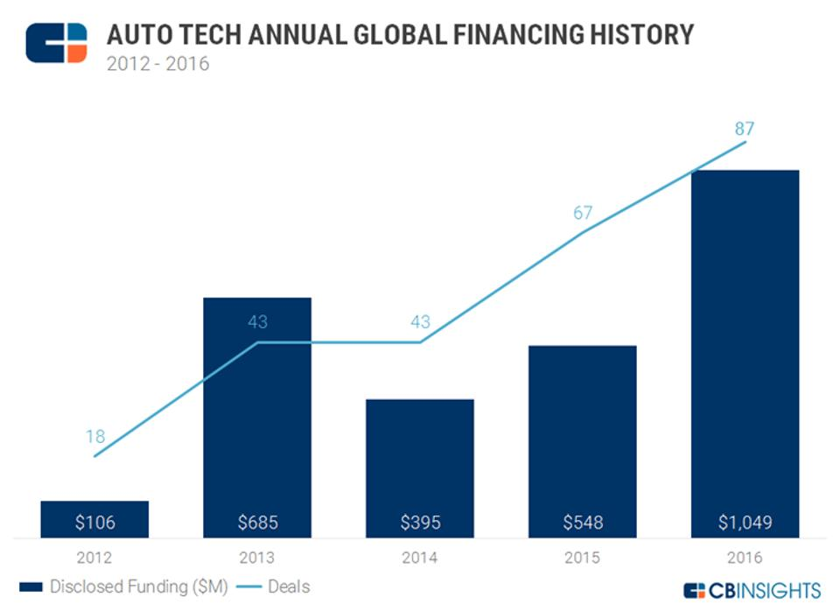

Slide 21
Thank You

Slide 22
GAUGING THE DISRUPTIVE POWER OF
ROBO-TAXIS IN AUTONOMOUS DRIVING
MIS 760-B
IT Strategy
Akshay Mulay
Xiting Wang
Wenpei Wang
Balaji Katakam
Swapnil Panchal
Jiancheng Zhao
Jianjie Gao

Slide 23
Table of Content
Title
Overview
Key Findings
Current situation of the technology
Business Strategy
Framework
Exploring mobility as a service
Steps by time
Business Future
Analysis Tools
Outcomes
Conclusion

Slide 24
GAUGING THE DISRUPTIVE POWER OF
ROBO-TAXIS IN AUTONOMOUS DRIVING
By Aditya Ambadipudi, Kersten Heineke, Philipp Kampshoff, and Emily Shao
Copyright © 2017 McKinsey & Company
https://www.mckinsey.com/industries/automotive-and-assembly/our-insights/gauging-the-disruptive-power-of-robo-taxis-in-autonomous-driving

Slide 25
Key Findings
Akshay Mulay
Focus will be on earning profits from per mile or per trip
Complete autonomous taxis or vehicles to evolve by 2030 in 3 different versions
Will challenge both incumbents and new entrants

Slide 26
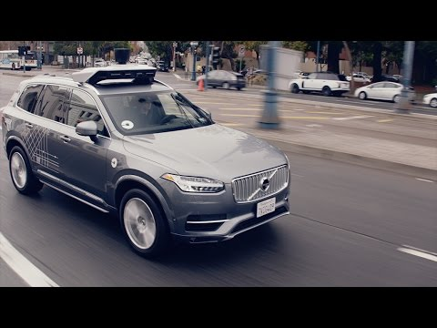

Slide 27
Current situation of the technology
Xiting Wang
Shared-mobility
Low cost compare to private-ownership
Autonomous driving
Remain in development stage
e.g.Robo-taxi-increasing automotive safety, have more mobility option, reducing the need for parking space

Slide 28
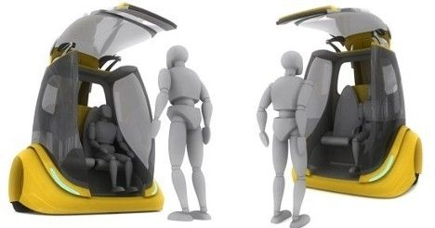
Xiting Wang
Business Strategy
Cross-industry convergence ：
Work closely with local governments
-Establish ground rules
-Available access high speed data
Focus on the Robo-taxi value chain
Raises new safety and security concerns

Slide 29
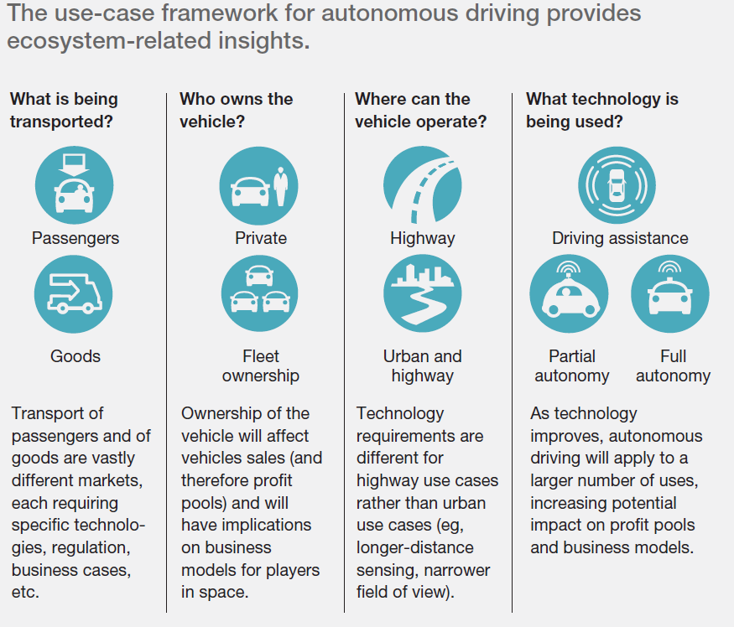
Balaji Katakam

Slide 30
The framework determines the following:
Where the AV operates.
Understanding where fleets can operate AVs (for example, on highways or local roads) helps frame the limits of the technology.
Likewise, the availability of specific infrastructure, such as the high-speed communications networks (for instance, fifth generation, or 5G) needed for successful over-the-air (OTA) software updates, will help fleets achieve total reliability in each operating environment.
What the vehicle will transport.
People or parcels?
Crystallizing an informed understanding of what the vehicle will transport can help businesses determine the best go-to-market strategies.
Based on customer differences, robo-taxis could conceivably transport passengers or goods, or both.
This raises vehicle-design questions as fleets attempt to achieve maximum utilization levels, for example, transporting people during the day and goods at night in the same vehicle.
Balaji Katakam

Slide 31
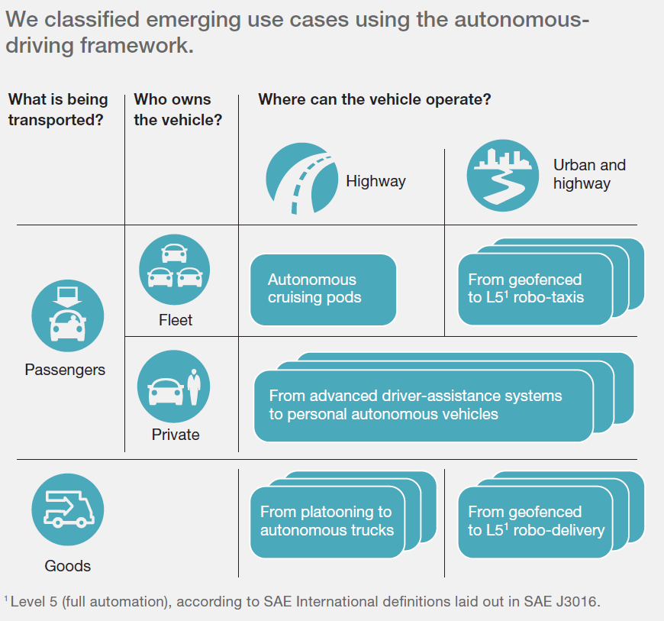
Exploring mobility as a service
Wenpei Wang
Notes:
The latest technology would make the significant difference in robo-taxi. It will offer service for both of passengers or goods. According to the different ownership, the operation method would go to various ways.

Slide 32
Exploring mobility as a service
Wenpei Wang
Different profit model
Improving profitability
Controlling the key technologies
Change the public-transportation
Lower cost
Enhancing driving safety

Slide 33
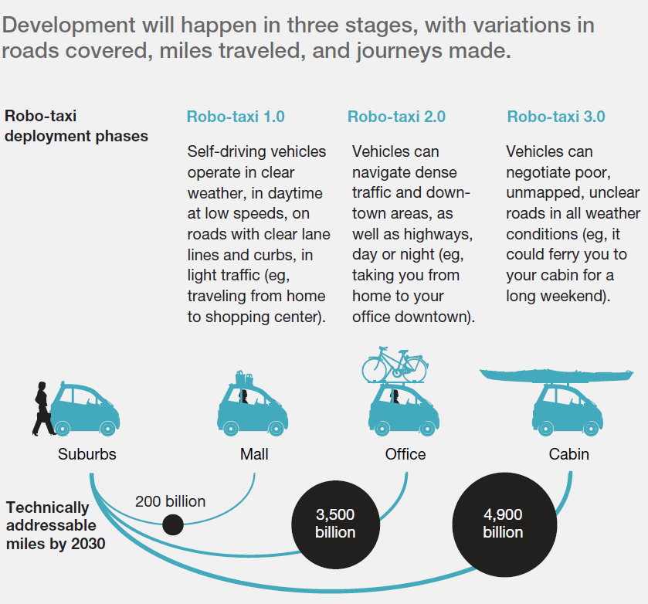
Jiancheng Zhao
200 billion
Basic self-driving in normal environment
3300 billion
Advanced self-driving in complex environment
1400 billion
Impeccable self-driving with extra service

Slide 34
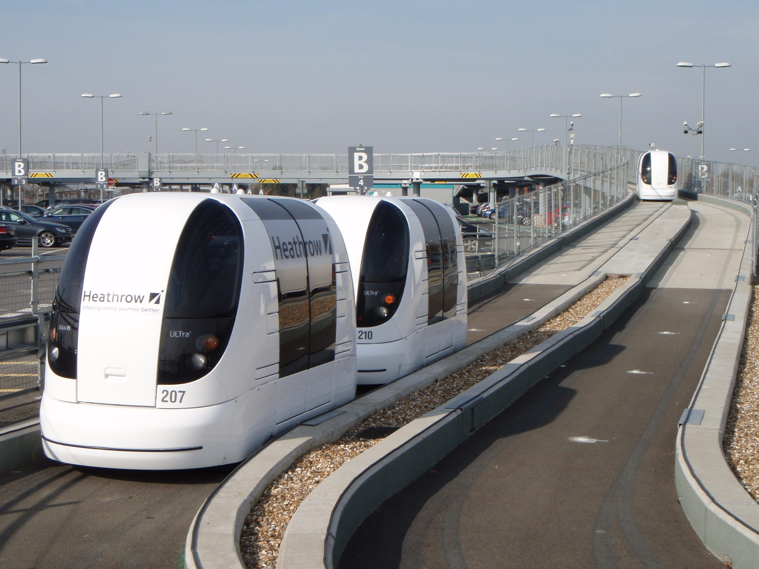
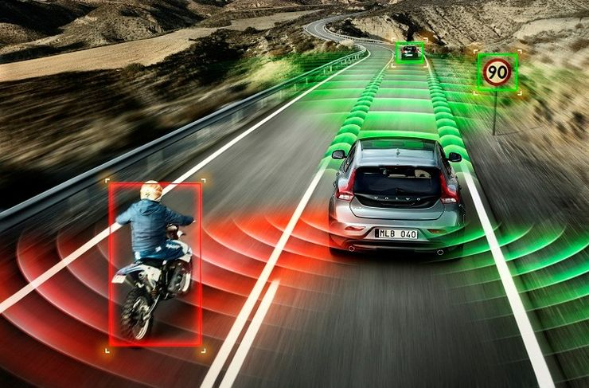

Steps by time
Jiancheng Zhao
2020-2022
2025-2027
By 2030

Slide 35
Business Future
Jianjie Gao
Cross-industry convergence
A successful robo-taxi ecosystem depend on the convergence of a wide variety of players
High-speed data access for transmitting smart traffic lights’ status;creation of new charging areas
Vehicle-to-infrastructure integration
Evolving plays require evolving players: who integrates
Notes:
huge undertakings in a rapidly changing environment

Slide 36
SWOT Analysis
Jianjie Gao
Strengths
Autonomous driving
Vehicle connectivity
Powertrain electrification
Shared mobility
Lower cost
Weakness
Needs to accumulate mileage for various circumstances
Hard for automakers to change role
Ecosystem: technology, regulation, customers, business
Time inconvenience
Opportunities
Reduce TCO to public-transport levels
Treating mobility as a service
Rapidly changing environment
Threats
Geofenced - regulation limits
Safety and security concerns
Fast respond
Robust cybersecurity measures
Notes:
TCO: total cost of ownership
a service-based, pay-per-mile business model and away from the classic product-centered pay-per-car approach.

Slide 37
Porter’s competitive forces
General view with automaker specific
Jianjie Gao
New Entrants
Tech accumulation
Infrastructure
Buyers
Adoption
Medium
ORGANIZATION
High
Suppliers
Automakers
Tech Suppliers
Rivalry
Integration
Transformation
Low
Substitutes
Private cars
Public transportation
Low
Medium

Slide 38
Outcomes
Swapnil Panchal
Transition to Robo-Taxi won’t be easy
Profit pools and control points will change
Software components system and vehicle level integration capabilities constitute profit pools and control points
Traditional automotive industry can enter market providing single AV solution and thereby eliminate new start ups and technological sectors.
This would impact risk & cost of new technology.
Generate different set of questions for consumers

Slide 39
New Questions for Customers ?
Will car ownership make sense ?
Trade car payments/insurance/maintenance with shared subscriptions ?
Commoditization of cars ?
Swapnil Panchal
New Questions for Automakers ?
Challenge to provide mobility as a service model !
What will it look like ?
How long will traditional car buying activity will prevail ?

Slide 40
Conclusion
Swapnil Panchal
Major Impact on Automotive Industry
Alternative to private car ownership
Mobility as a Service
Competition between New and Incumbent mobility industry
Seek profitable and sustainable growth in unfamiliar environment

Slide 41
Thank You

